Slide 1

Techniques of Speaking · COM230
The Ironman
Born From an Argument
A speech on where the Ironman came from, how a bar-style debate
turned into a 140.6-mile race, and why people keep signing up.
2.4mi Swim
112mi Bike
26.2mi Run

Slide 2
Overview
Where we're headed
01
02
03
Where it came from
How it took shape
Why people still do it
A bar-style debate that turned into a proposed race
Three brutal races stitched into one single day
It's rarely about the medal — it's personal
3

Slide 3
The Basics
What Is a Triathlon?
The range of distances
1
Sprint
A triathlon is a single race that strings three disciplines together, back to back, on one continuous clock: swim, then bike, then run. No breaks except to change gear.
0.5mi swim, 12.4mi bike, 3.1mi run
2
Olympic
0.93mi swim, 24.8mi bike, 6.2mi run
An Ironman is simply a triathlon —
its longest, hardest distance.
3
Ironman 70.3
1.2mi swim, 56mi bike, 13.1mi run
4
Full Ironman
2.4mi swim, 112mi bike, 26.2mi run
3

Slide 4
Introduction
Hawaii, 1977.
Who was arguing
1
Runners
A room full of athletes at an awards banquet. The runners think they're the toughest. The swimmers disagree. Someone brings up a magazine article claiming a cyclist has the highest recorded oxygen uptake ever measured. Voices rise. Nobody backs down.
Claimed marathoners were the fittest athletes
2
Swimmers
Pointed to grueling open-water endurance
And out of that one argument came one of the hardest
single-day races on Earth.
3
Cyclists
Backed by a stat: Eddy Merckx's oxygen uptake
2

Slide 5
Origins
Not a lab. Not a committee.
A real argument.
The oxygen claim
Eddy Merckx
Belgian cyclist cited for the highest recorded oxygen uptake at the time — the spark that turned a friendly rivalry into a proposal.
At the 1977 awards ceremony for the Oahu Perimeter Relay, members of a local running club and swim club argued over who was more fit. Then U.S. Navy Commander John Collins jumped in: Sports Illustrated had just credited cyclist Eddy Merckx with the highest oxygen uptake ever recorded — maybe cyclists were the real athletes.
Feb 18, 1978
The first fifteen athletes show up on the beach to settle it.
“Whoever finishes first, we'll call him the Iron Man.”
— John Collins, proposing the challenge
4

Slide 6
The Challenge
Three races. One single day.
Collins and his wife Judy combined the toughest existing endurance races on Oahu into one event.
2.4 mi
112 mi
26.2 mi
Waikiki Roughwater Swim
Around-Oahu Bike Race
Honolulu Marathon
15 started · 12 finished
The runner-up, John Dunbar — a U.S. Navy SEAL — was actually leading the race until he ran out of water on the marathon. His crew handed him beer instead.
5

Slide 7
The Meaning
It's rarely about the medal.
~17
The race moved to Kona on Hawaii's Big Island in 1981 and became the World Championship. From there it exploded — full-distance races, and the shorter 70.3 "half Ironman" for people building up to the real thing.
Hours of continuous effort — the cutoff most races allow
There's no way to fake 17 hours of continuous effort. Every finisher — fast or slow — answers the same question: can I keep going when my body says stop?
2.4 mi swim + 112 mi bike + 26.2 mi run
Crossing the line is less about beating someone else, and more about becoming someone slightly different than who started that morning.
6

Slide 8
The Evolution
How far we've come
Same 140.6 miles. Three very different eras.
1978
2024 · Kona
World Record
11:46:58
7:35:53
7:21:12
Gordon Haller — first-ever finisher, the original Ironman
Patrick Lange — World Championship course record, the hardest course in the sport
Kristian Blummenfelt — Ironman Cozumel 2021, fastest official iron-distance time anywhere
4 hrs 26 min faster
than the inaugural 1978 finish — 46 years of training, nutrition, and equipment improving together. Kona's heat and wind still make it the toughest test, which is why its record trails the flat-course best.
7

Slide 9
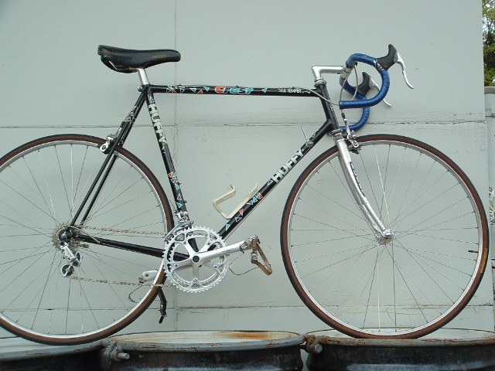
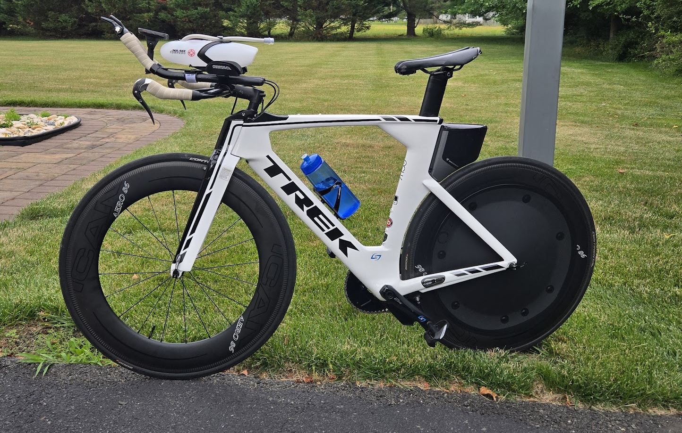
The Gear
The bike
Steel and drop bars vs. carbon and aerodynamics.
1978
Today
A steel-frame road bike with drop bars — no aerodynamics to speak of.
Carbon-fiber aero frame, aero bars, and a disc wheel built to cut through wind.
8

Slide 10
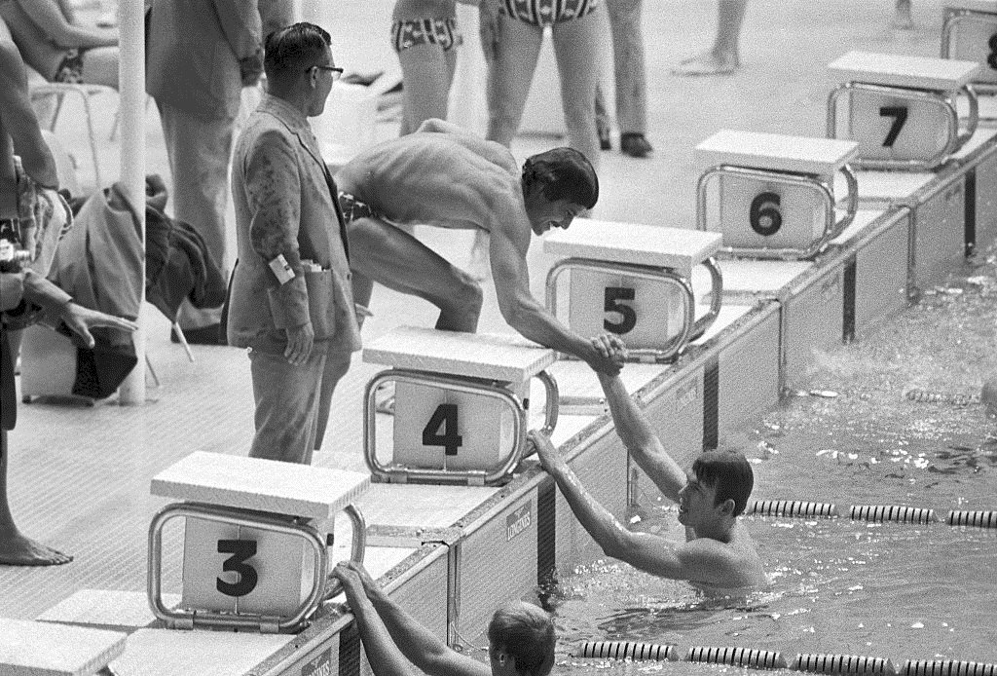
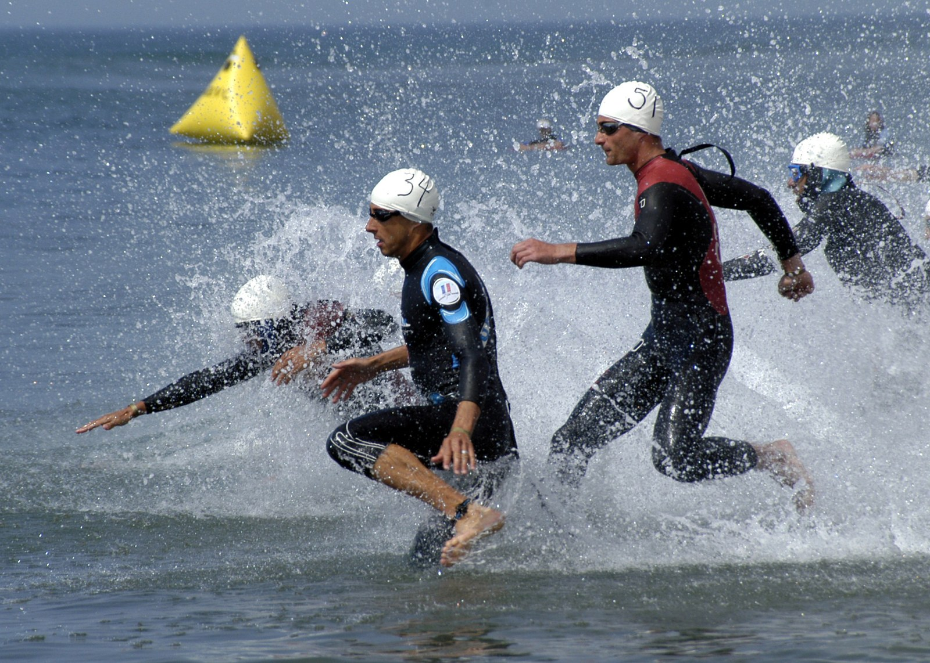
The Gear
The wetsuit
From bare shoulders to engineered buoyancy.
1978
Today
No wetsuit — athletes swam in briefs in Hawaii's warm water.
Tri-specific wetsuits engineered for buoyancy, flexibility, and speed.
9

Slide 11
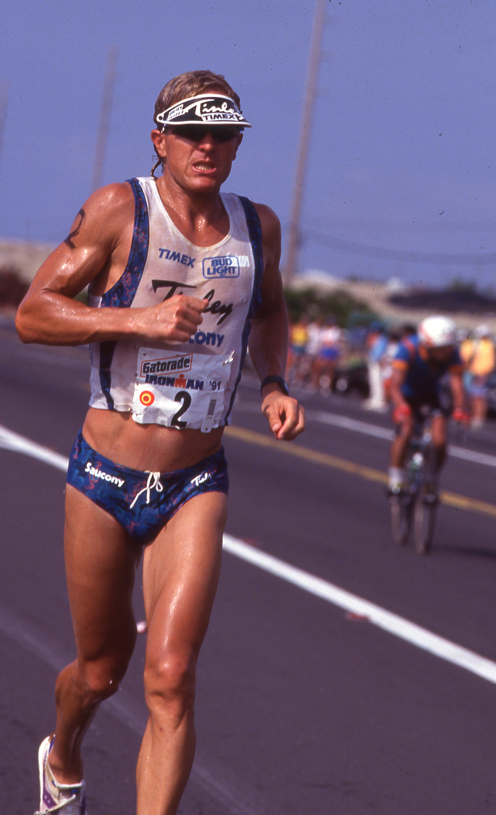
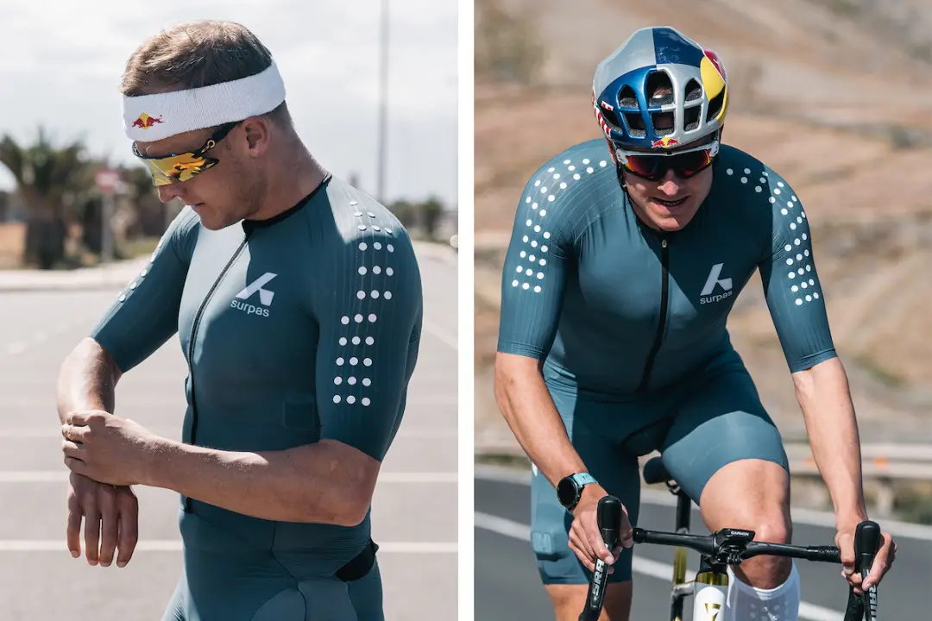
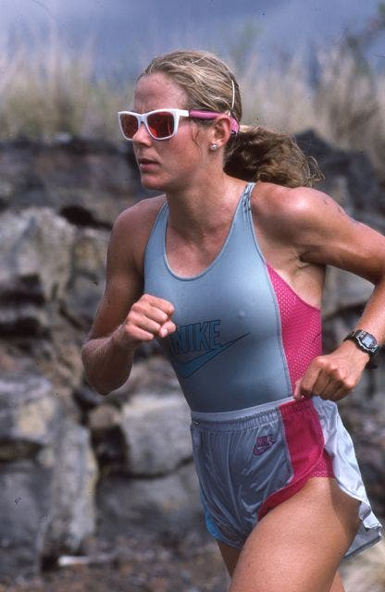
The Gear
The tri suit
From cotton and cutoffs to a single aero suit.
1978
Today
Ordinary running clothes — cotton tees and shorts, nothing built for triathlon.
A one-piece aerodynamic suit worn for all three legs of the race.
10

Slide 12
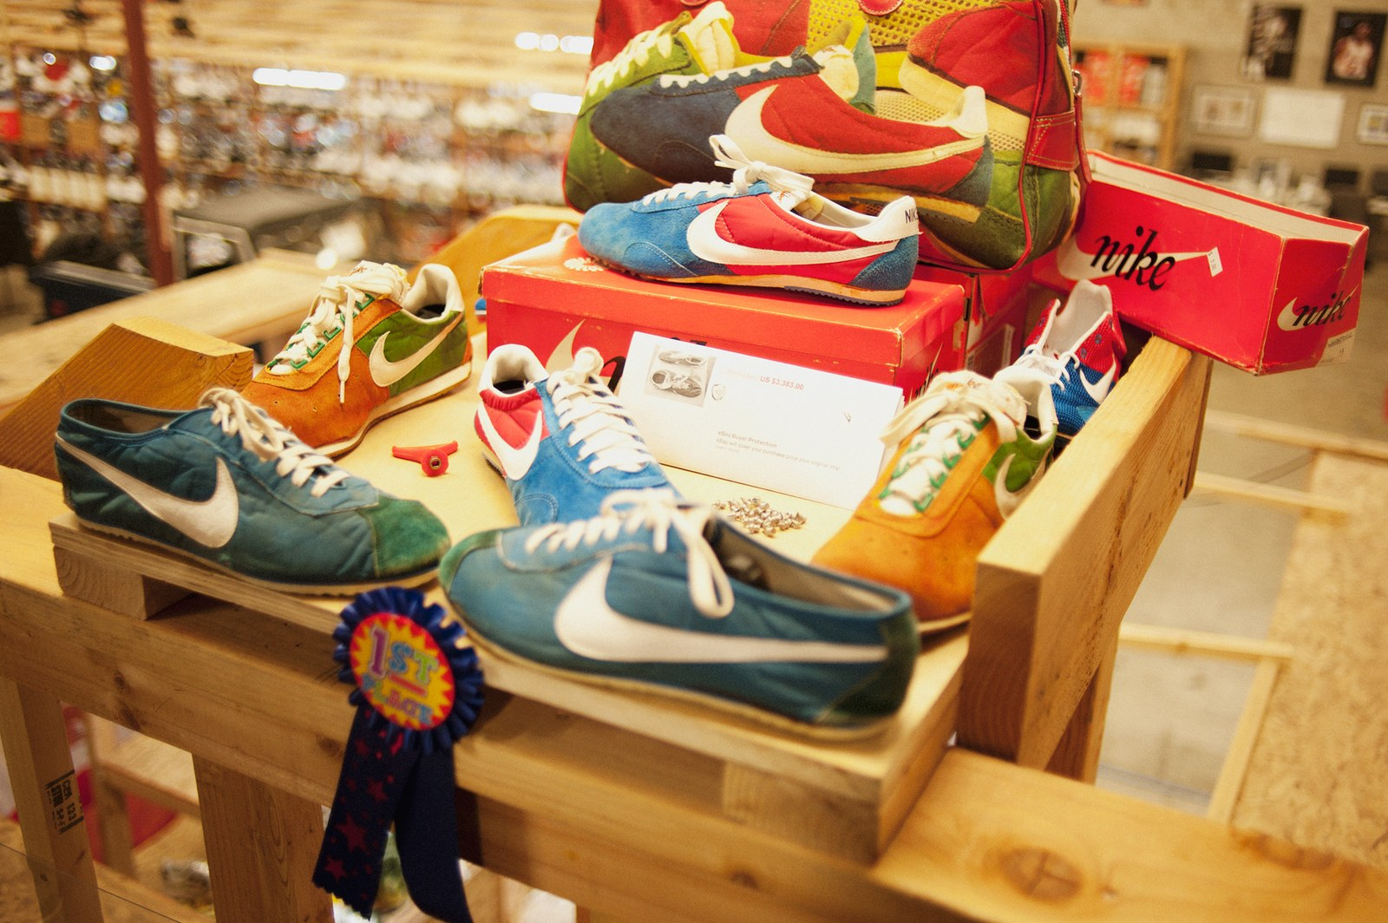
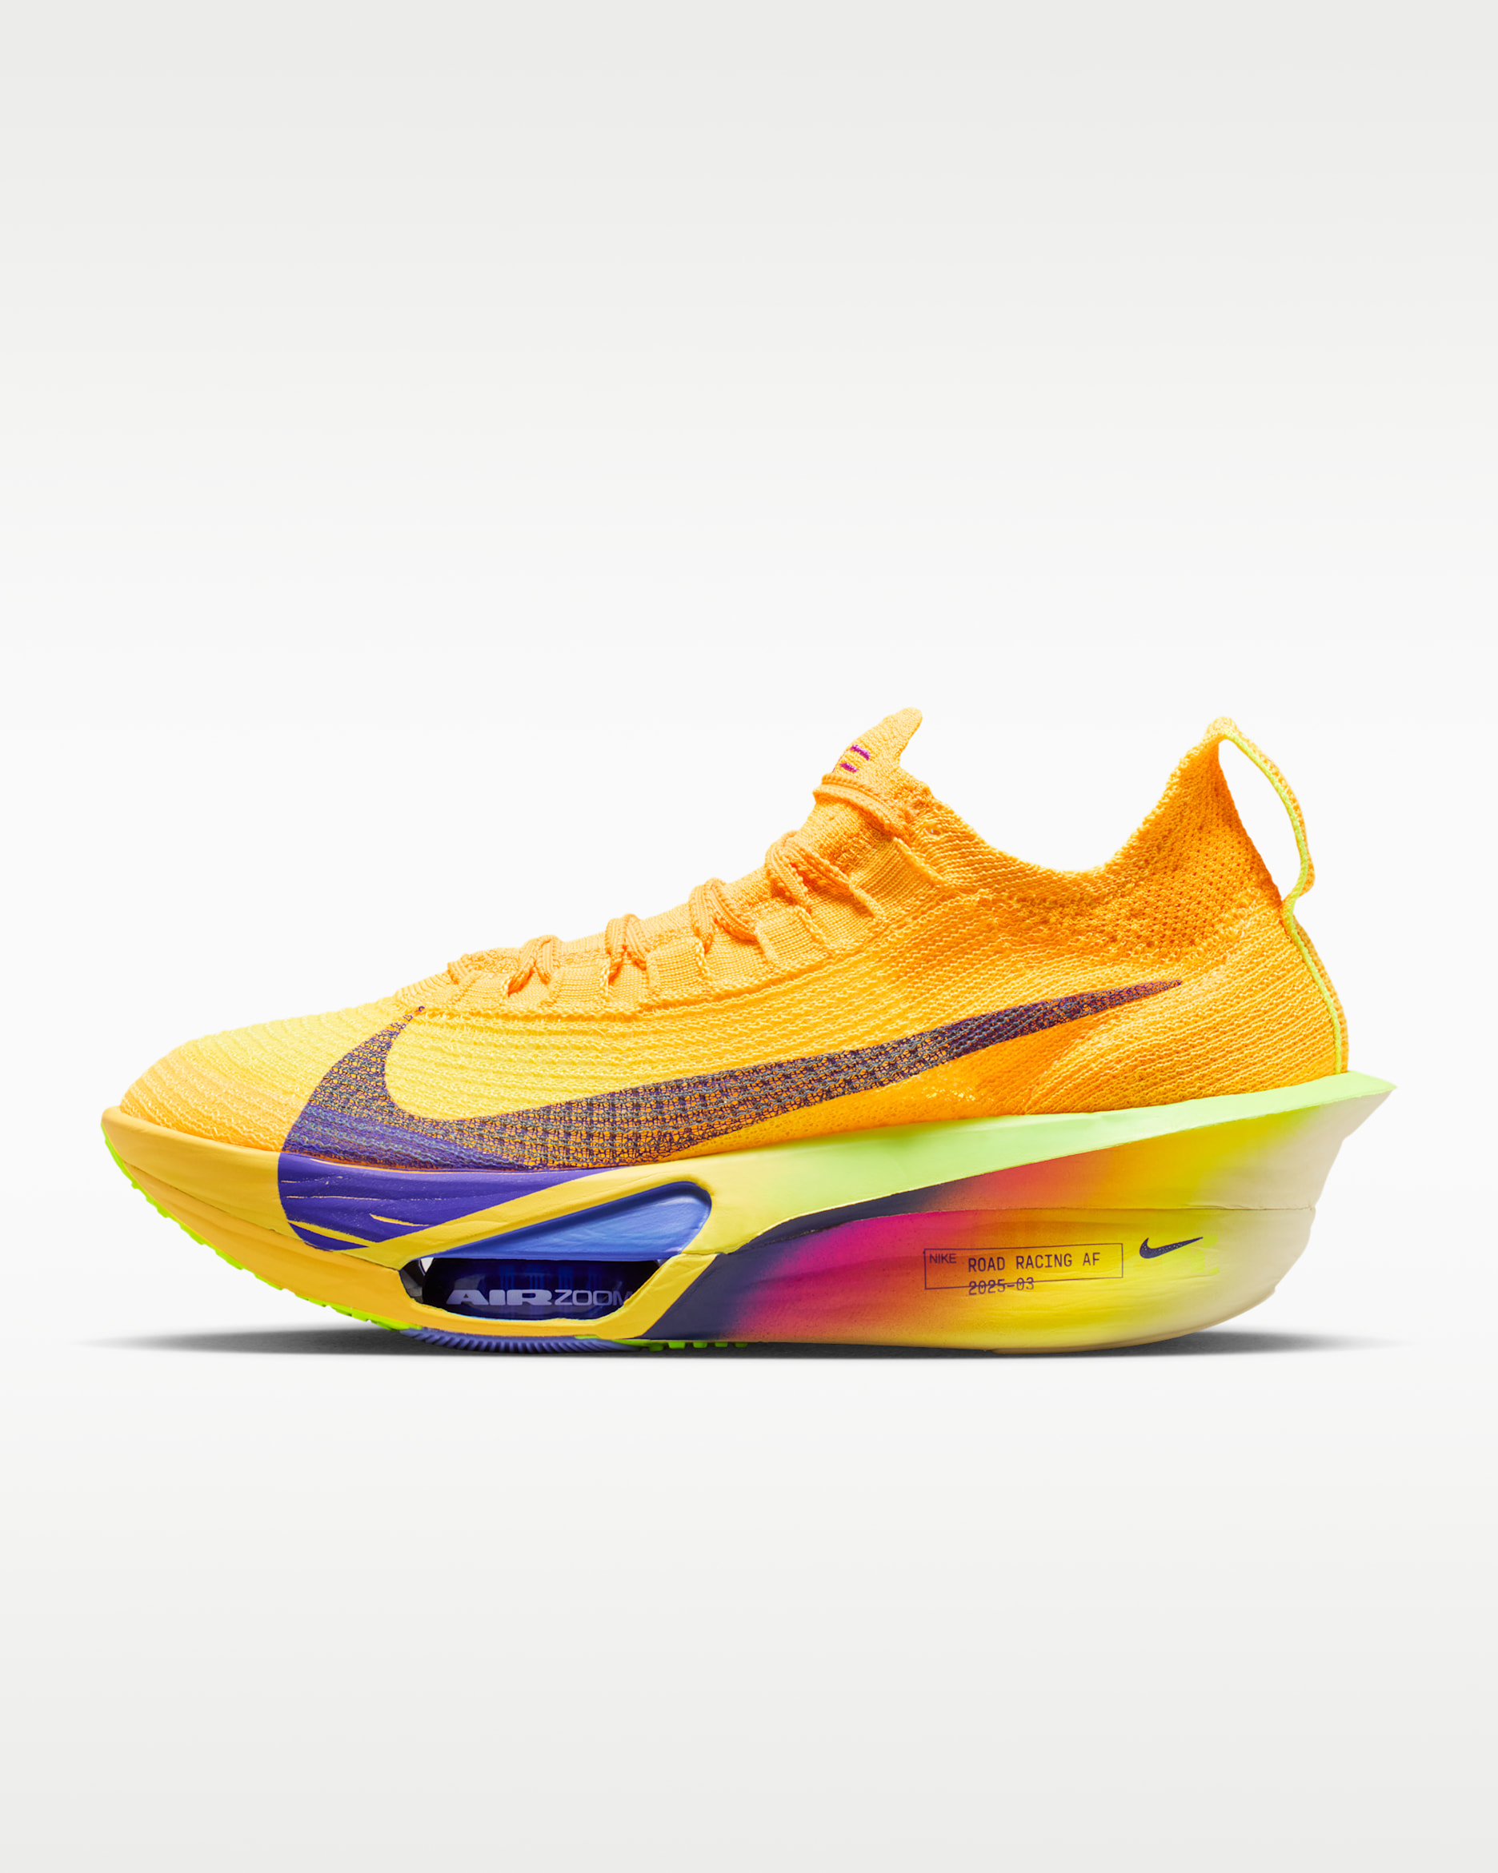
The Gear
The shoes
From standard sneakers to a carbon-fiber engine.
1978
Today
Standard training sneakers — nothing race-specific existed yet.
A carbon-fiber plate inside a "super shoe," built for a faster closing marathon.
11

Slide 13
Conclusion
Nothing left to argue about.
What began as a heated argument at a Hawaiian awards dinner about swimmers, runners, and cyclists turned into a race that settles the debate — because in the Ironman, everyone has to be all three.
It's not just a competition anymore. It's a test people choose to take on themselves — because the person who finishes it is never quite the same as the person who started it.
1977 — The Argument
1978 — The First Race
Today — A Global Test
12

